Slide 1


DATA VERSIONING
GLOBAL SOFTWARE CONSULTANCY
Emily Gorcenski
Lead Consultant, Data Science
ThoughtWorks Germany

Slide 2

WHAT IS A
VERSION?
Fundamentally, a version is a description of a system at a point in time.
A version encodes meta-information about the development history, the feature set, the bugs, the compatibility, the dependencies, and so forth.

Slide 3
WHAT A VERSION TELLS US
SEMVER
3.08.121
Semver is designed to address dependency complexity, telling us the history of bug fixes and features and whether or not a piece of software breaks functionality compared to earlier versions.
Major—breaking change from lower numbers
Minor—backward-compatible feature addition
Patch—backward compatible bug fix

Slide 4
WHAT A VERSION TELLS US
TeX
3.14159265
TeX uses an idiosyncratic version labeling scheme that converges asymptotically to π from below.

Slide 5

WHAT A VERSION TELLS US
TeX
3.14159265
TeX uses an idiosyncratic version labeling scheme that converges asymptotically to π from below.
The current version number tells us that Donald Knuth is still alive.

Slide 6

WHAT ABOUT
CONTINUOUS DELIVERY?
Continuous Delivery environments require us to be able to rollback to any previous version at any point in time.
It also means our version is continuously changing, and that two adjacent versions represent only small changes in the state of the system.

Slide 7
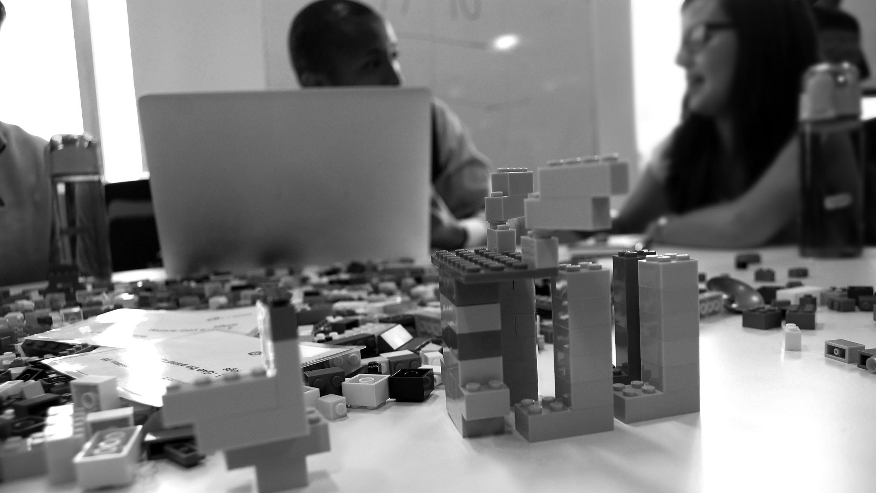
SO HOW DOES THIS APPLY TO DATA?

Slide 8

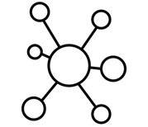

PRODUCTIONIZED MACHINE LEARNING/AI SYSTEM
Unlike deterministic systems, data-driven software depends on more than just source code.
+
+
Data
Model
Code

Slide 9
HOW DOES CODE CHANGE VERSION?
Code
Bug fixes
New features
Dependencies
Operating systems
Scope change
Etc.
This axis is the best-understood axis of version change for machine learning systems.
Code is a broad concept. It can refer to the source code of our services and systems. It can represent our infrastructure. It can refer to the code used to access, transform, or prepare data. It can refer to the code used to train, validate, and assess models.

Slide 10
HOW DOES A MODEL CHANGE VERSION?
Model
Research — trying new approaches
Dependencies
New data
Performance improvements
Etc.
This axis is not as well-understood and machine learning, as a field, is changing so rapidly that many models can be expected to be obsolete in short order.
Model here refers to both the modeling approach (e.g. random forest classification) and the actual artifact produced (e.g. a pkl file). A model is a product of hyperparameters (not varied during training) and parameters (computed during training).

Slide 11
DATA IS MORE COMPLICATED
Data

Slide 12
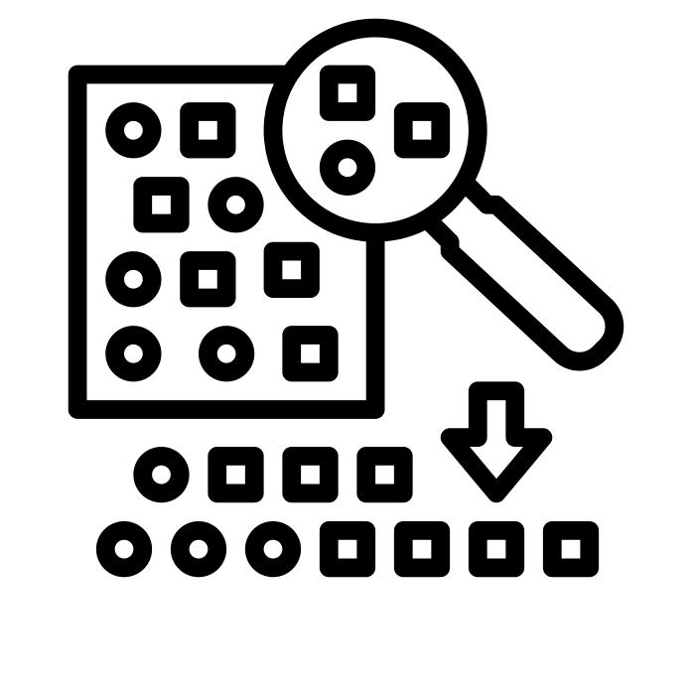

DATA IS MORE COMPLICATED
Data is an assessment of the state of the universe at a point in time. It has a measurement and a shape.
Sampling
Schema
Data
Random Sample by Becris from the Noun Project, Puzzle by shashank singh from the Noun Project

Slide 13
HOW DOES SAMPLING CHANGE VERSION?
Sampling
Time—it marches ever on
Extrinsic changes in the universe
Inserts, Deletions, Updates
Etc.
It is very difficult to specify or detect shifts in “versions” here except by example. We often think of this as moving forward with time, but that versions are not necessarily time-dependent.
Sampling refers to the values in the data themselves. We can’t measure everything, but what we do measure is a sample of the universe. These values have properties like support, distribution, cardinality, etc.

Slide 14
HOW DOES SCHEMA CHANGE VERSION?
Schema
Software updates
Requirements changes
Migrations
Etc.
It is very difficult to specify or detect shifts in “versions” here except by example. We often think of this as moving forward with time, but that versions are not necessarily time-dependent.
Schema refers to the shape of our data. This can be a database schema, e.g. a table/column/constraint definition, or it could just refer to shape of the incoming data (e.g. JSON fields, XML schema, etc).

Slide 15
ML SYSTEMS HAVE FOUR “VERSION AXES”
Any data-driven service can experience version drift along any of these axes independently or jointly.
Sampling
Code
Schema
Model
Random Sample by Becris from the Noun Project, Puzzle by shashank singh from the Noun Project

Slide 16
LET’S HAVE SOME EXAMPLES

Slide 17

FRAUD DETECTION
A retail company builds a classifier to detect possible fraudulent purchases. It runs for over a year with no changes. One day, it is announced that a major electronics retailer had a data breach and 60 million credit card numbers were exposed for over three months.
Sampling

Slide 18
FRAUD DETECTION
A retail company builds a classifier to detect possible fraudulent purchases. It runs for over a year with no changes. One day, it is announced that a major electronics retailer had a data breach and 60 million credit card numbers were exposed for over three months. You retrain the model to account for these data.
Sampling
Model

Slide 19
FRAUD DETECTION
A retail company builds a classifier to detect possible fraudulent purchases. It runs for over a year with no changes. One day, it is announced that a major electronics retailer had a data breach and 60 million credit card numbers were exposed for over three months. You add a flag that says if a customer’s data was discovered in the breach.
Sampling
Schema

Slide 20

DYNAMIC TRAFFIC
You run an AI system to help control traffic flow. One day, the transit service changes their API. Their new service returns JSON instead of XML, adds a live passenger count instead of an average passenger estimate, and removes the “number of train cars” field.
Code
Schema

Slide 21
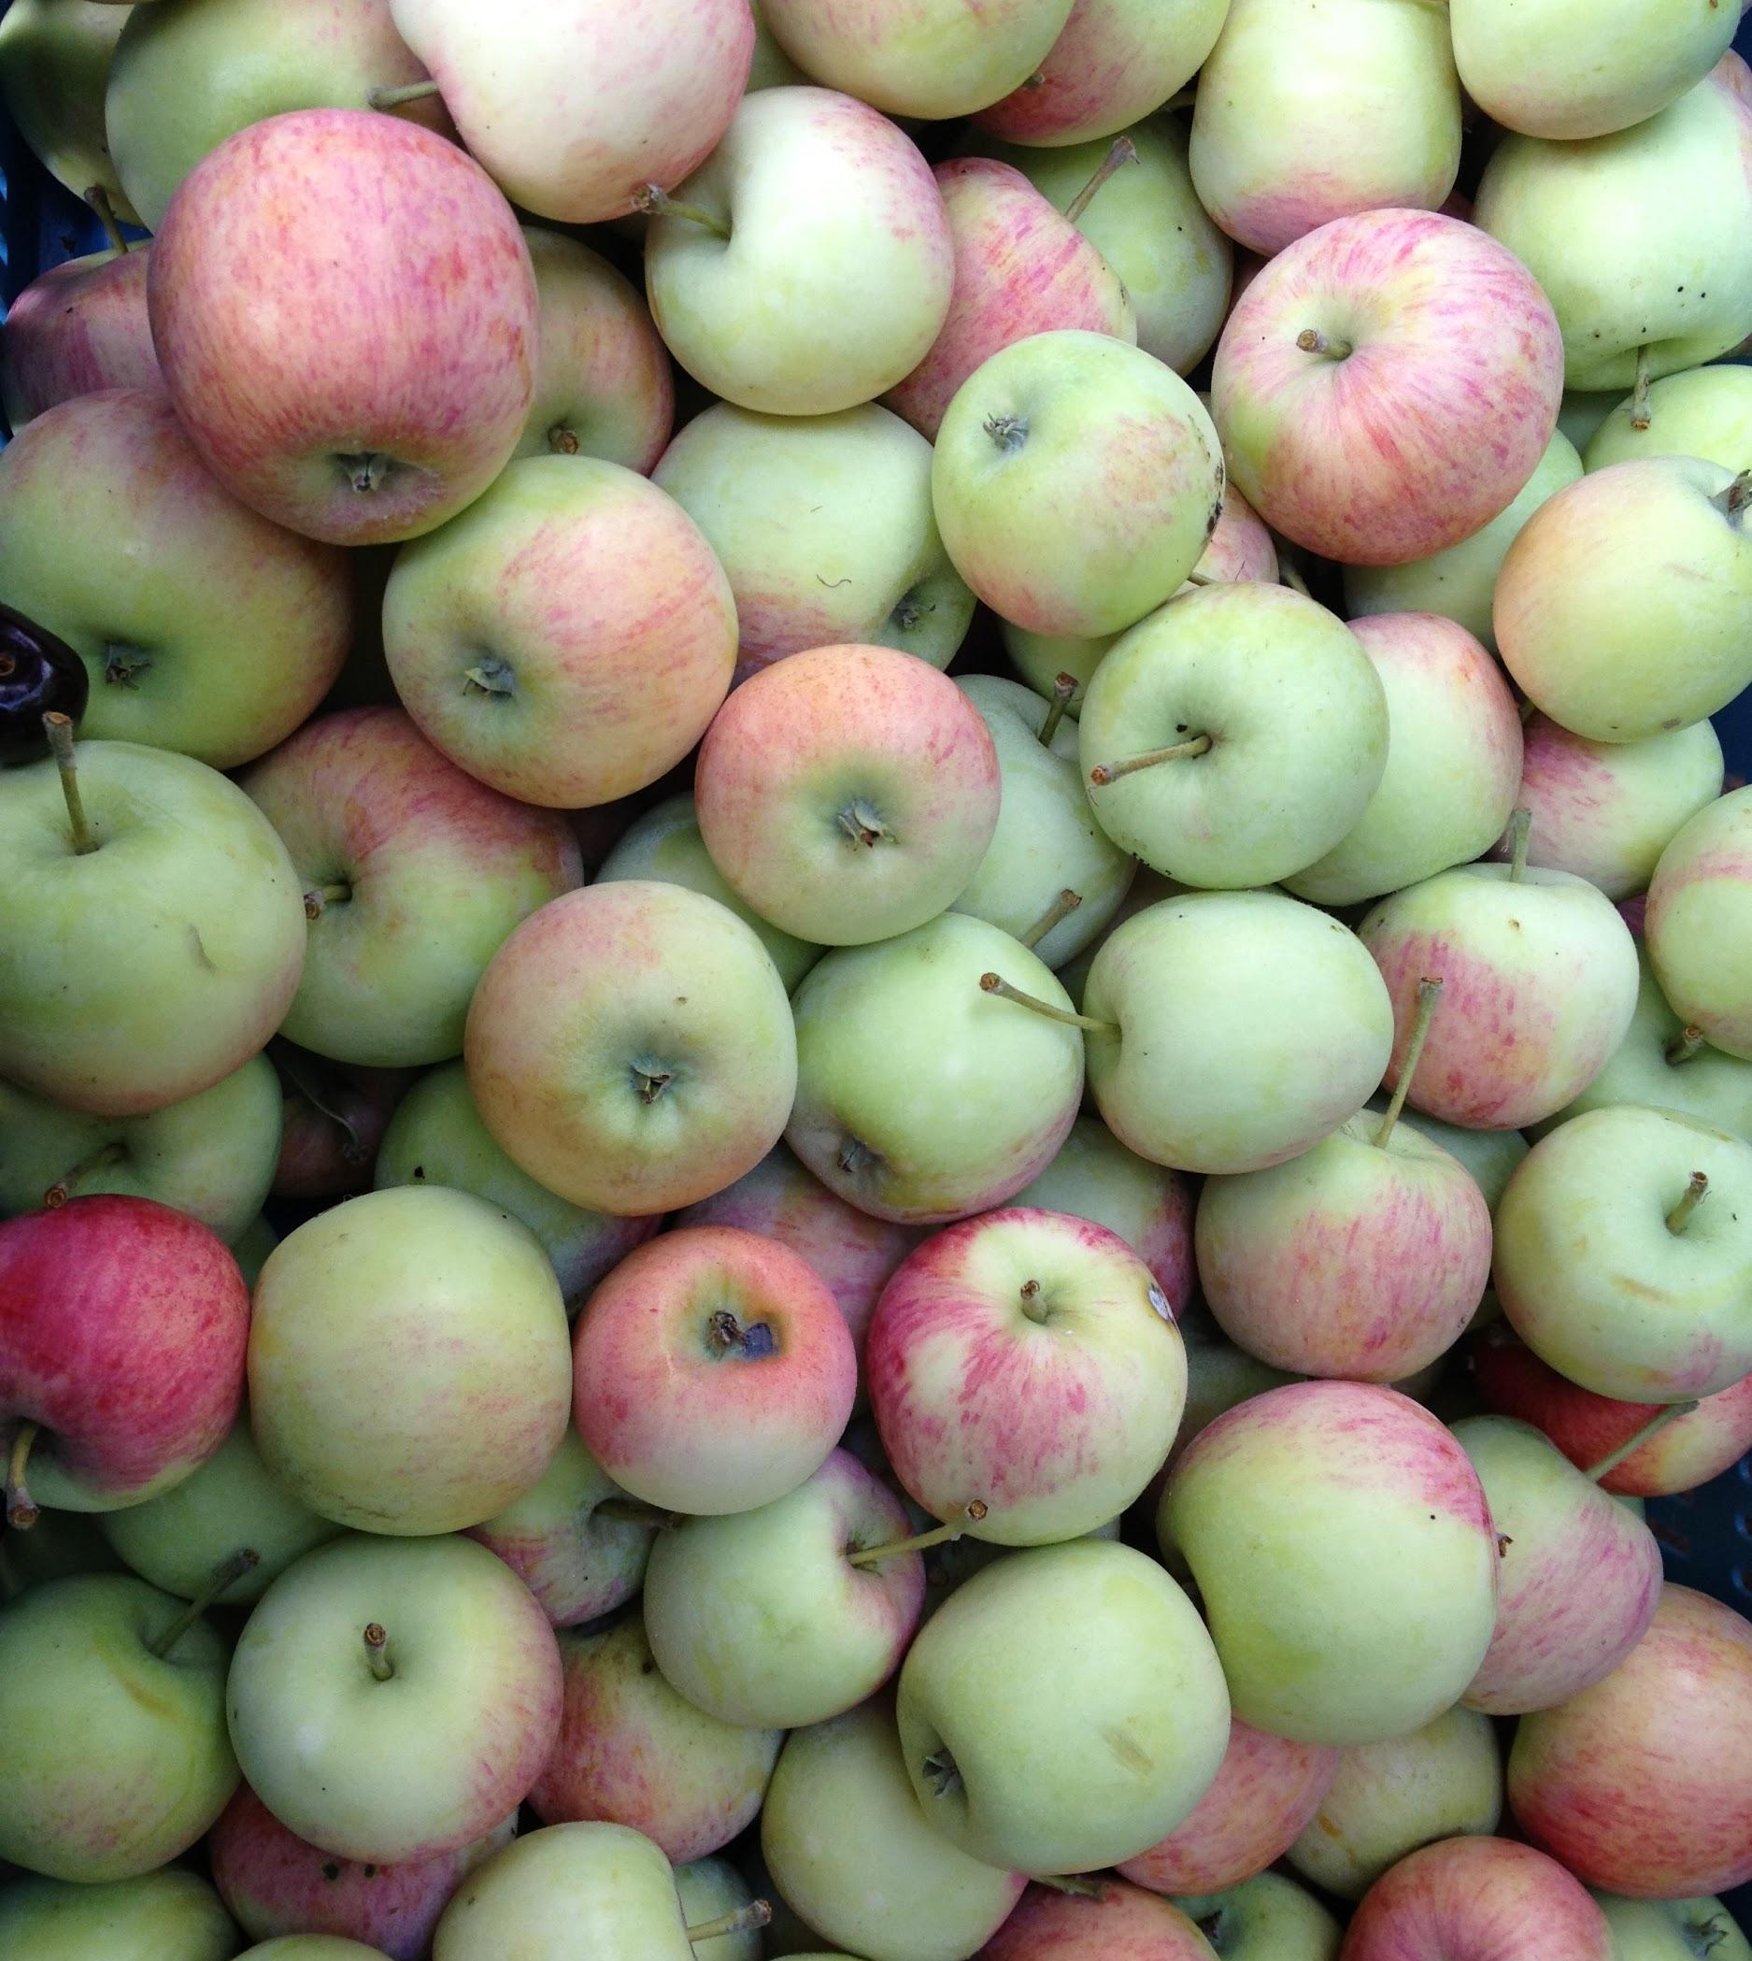
PRICE PREDICTION
A grocer wants to predict the price of produce. You build a model that performs well. Sometime later, an update to Tensorflow makes available an even better approach, but it only works with Python 3.6, and your production stack runs Python 3.5.
Code
Model

Slide 22
WHY DOES ANY OF THIS MATTER?
Degree of control: You may have little or no control over how variations happen on one axis or another
Continuous improvement: Understanding the degrees of freedom of your is necessary to understand how to allocate resources for continuously improving it.
Knowing what breaks (and how): Analysis of failure is necessary for any complex software system and breaking down the degrees of freedom of data-driven system failures helps quality engineering.

Slide 23
ADDRESSING THE CHALLENGE

Slide 24
COUPLING MODEL AND CODE
A model is an output artifact of some code, and that code can be version controlled like normal.
Benefits: familiar workflows; uses mostly existing tools
Drawbacks: not reproducible!—does not account for data or schema changes, therefore rollback not guaranteed possible; artifacts are still big; lots of hard-coded “magic”
Opportunities: take inspiration from infrastructure-as-code
+
Code
Model

Slide 25
LINK SAMPLES AND SCHEMA
Our data usually gets stored and inherits a schema, so just let these be linked.
Benefits: easy, can just dump a table, etc.; no need to impute data; no need for complex adapters
Drawbacks: creates hard discontinuities in a continuous universe; schemas not always easily adaptable; leads to heavy migrations, lots of adapter/ad-hoc ETL/transform code
Opportunities: build better tools for handing structured vs. unstructured data
+
Sampling
Schema

Slide 26
USE VERSION CONTROL FOR DATA
Treat data (and possibly model) artifacts as large objects stored in the cloud and version control access pointers
Benefits: more comprehensive; close to existing workflows
Drawbacks: tooling is immature; huge storage requirements; code and data only barely linked at all
Opportunities: improve tooling; develop more context-aware data access patterns
Code
+
+
Sampling
Schema

Slide 27
UNLINK YOUR CODE FROM MODELS/DATA
Let your code be code, let your data be data, let your models be models
Benefits: it’s comforting to envision the world differently than it is
Drawbacks: nothing but problems; data scientists in a silo; small changes lead to large problems, possibly down the road
Opportunities: embrace continuous delivery!
Code
+
Sampling
Schema
Model

Slide 28
RESTRICT MODELING APPROACHES
Set a high barrier to any changes to data schemas. Choose a specific modeling approach and optimize around that.
Benefits: restricts possible degrees of freedom; builds up institutional expertise
Drawbacks: have to have confidence in approach; very hard to pivot later on; breeds some very ad-hoc architectures
Opportunities: use learnings to build more robust tools, frameworks, and approaches; commoditize specialized knowledge
Code
+
+
Sampling
Schema
+
Adaboost

Slide 29
THE FOUR AXES
You may or may not have to care about how changes along these axes affect your product, your service, or your development process. But they are each unique enough to have their own challenges.
Sampling
Code
Schema
Model

Slide 30

THANKYOU
EMILY GORCENSKI LEAD CONSULTANT, DATA SCIENCE
egorcens@thoughtworks.com | thoughtworks.com

